Slide 1
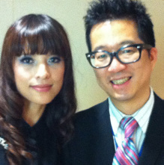
美安購物年金
The Shopping Annuity
Game Changer or New Game?
Calvin Ip & Rose Wong
顧問經理級
Supervising Coordinator
四個佣金週期共賺取HK$57,500
HK$57,500 in 4 Commission weeks
本簡報中提到的收入等級純屬舉例說明，無意代表美安香港經銷商的一般收入，也無意表示任何經銷商皆可賺取同等收入。美安香港經銷商的成功與否，取決於其在發展事業時的努力、才能與投入程度。The income levels mentioned in the following presentation are for illustration purposes only. They are not intended to represent the income of a typical Market Hong Kong Distributor, nor are they intended to represent that any given Independent Distributor will earn income in that amount. The success of any Market Hong Kong Independent Distributor will depend upon the amount of hard work, talent, and dedication which he or she devotes to building his or her Market Hong Kong Business.

Slide 2
美安購物年金
The Shopping Annuity

Slide 3

我們的消費
Our Spending

Slide 4

儲蓄
Our Saving

Slide 5

年金儲蓄
Annuity
退休金

Slide 6
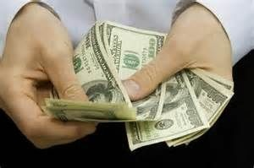

年金儲蓄
Annuity
一次性或定期供款
在指定日期後領取
資產性收入
Lump sum or fixed installment
Income after a fixed date
Asset income

Slide 7


Slide 8


Slide 9
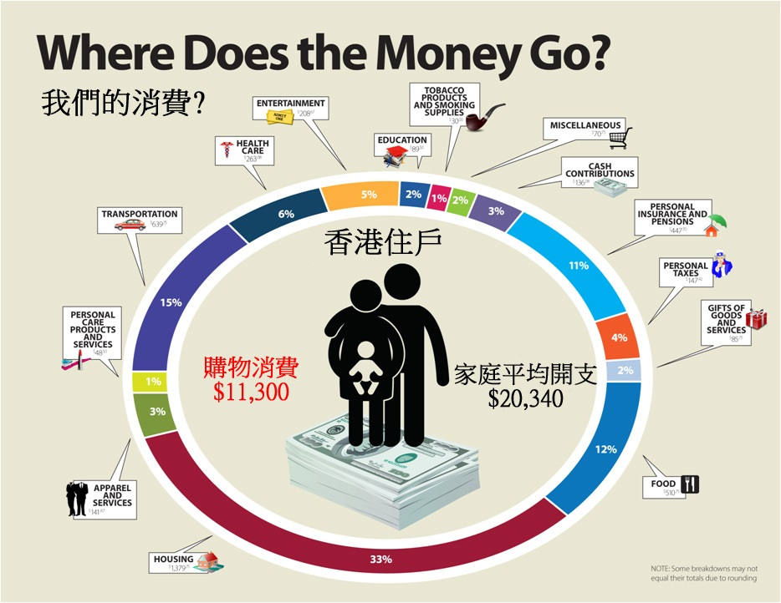
娛樂
煙草產品
雜項
教育
醫療
現金捐贈
保險
退休金
交通
稅項
個人護理
送禮
衣服
食物
住屋

Slide 10

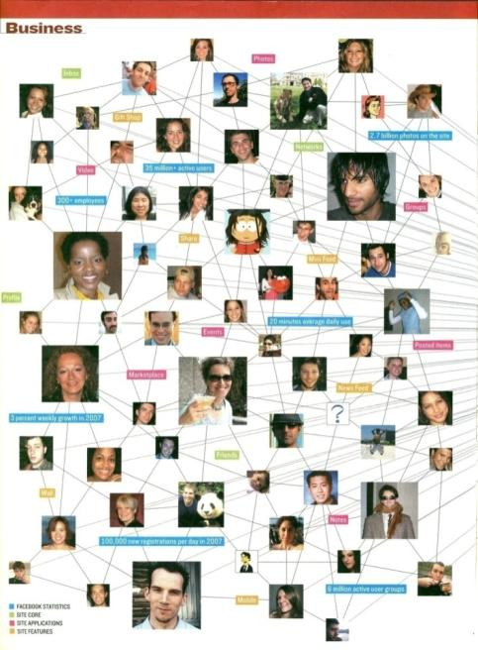

你的錢往哪裡去？
Where Does the Money Go?
＄
＄
＄
＄
＄
＄
＄
＄
＄
＄
＄
＄
＄
＄
＄
＄
Notes:
先說明，消費必定產生利潤，只是誰賺走的問題。
大多數的利潤都落入少數財團的口袋中─
要以7-11、家樂福、百貨公司消費為例說明。

Slide 11
到底在哪裡能把消費轉為投資
為我們日常的購物省錢
同時帶來收入？
“Turn spending into earning: Savings and convert shopping into income!”
Where else can you do this?

Slide 12
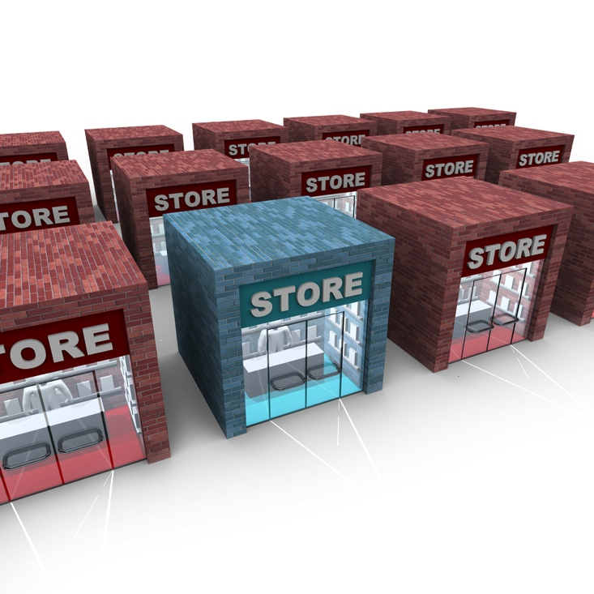
BRICK AND MORTAR
傳統消費
Brick and Mortar

Slide 13

改變消費習慣
Click and Order

Slide 14

美安香港優勢
How do we put it all together?
系統跟進消費
Tracking System to track all orders
每人都想節省金錢
People have less $,
NO $ to Save or Invest
所有人生活都要購物/消費
(勒緊褲頭)
方便購物體驗
Automation Program to find what you are buying
People must SHOP /Spend to Live
(Tighten Belt)
提供更佳產品及優惠
We provide Shopping & Savings for everyone
MA Products to Brick and Mortar, Savings Better
改變消費習慣
Brick and Mortar to
Click and Order

Slide 15
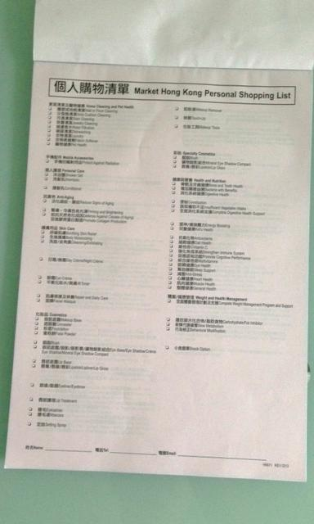
消費轉成投資
Spending to Earning
勾選現有消費品
立即換算對等BV
三個月內全面轉換
Convert your Spending into BV items

Slide 16
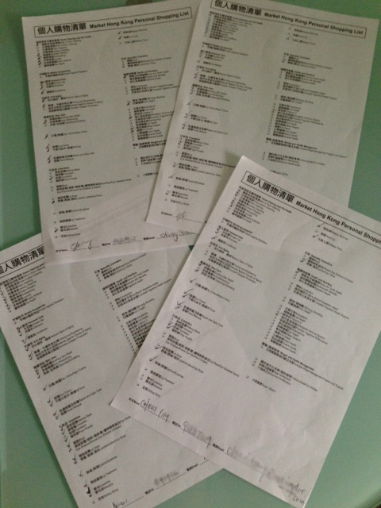
利用家居購物清單
Use the Home Shopping List
和朋友夥伴分享
提供購物建議
Share with Partners and Friends
Shopping Suggestions

Slide 17
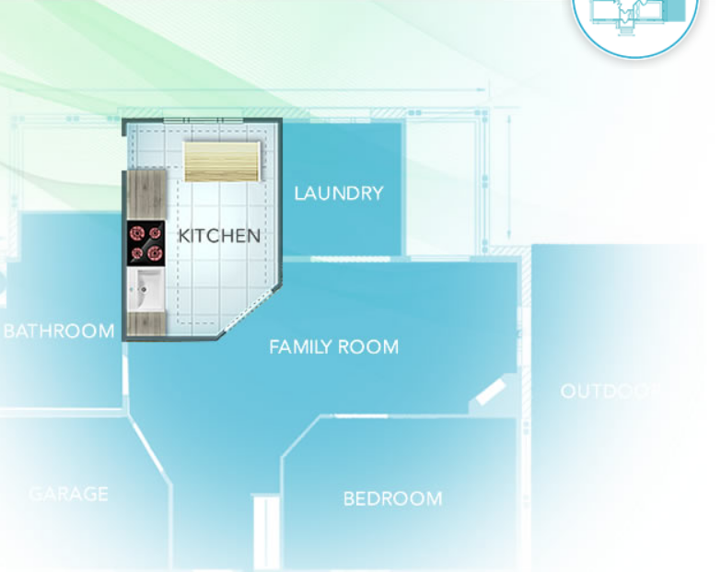


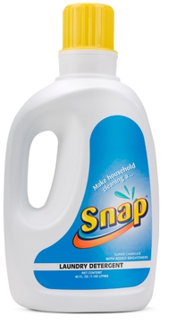
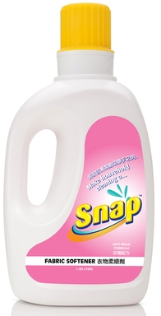


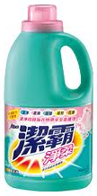


Snap
抗菌洗潔精
Dishwashing
Liquid
Snap
洗衣液
Laundry
Detergent
Snap
衣物柔順劑
Fabric Softener
Snap
萬用清潔劑
Multi-purpose Natural Concentrate
洗碗液
Dishwashing Detergent
洗衣液
Laundry
Detergent
柔順劑
Fabric
Softener
清潔劑
Cleaner
22 BV

Slide 18
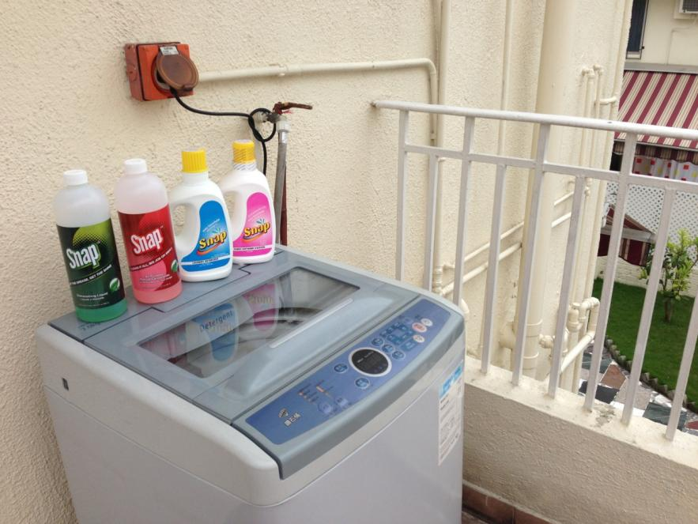
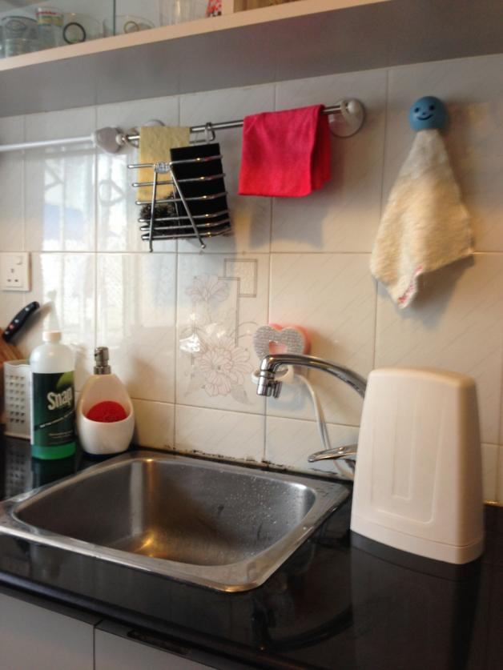
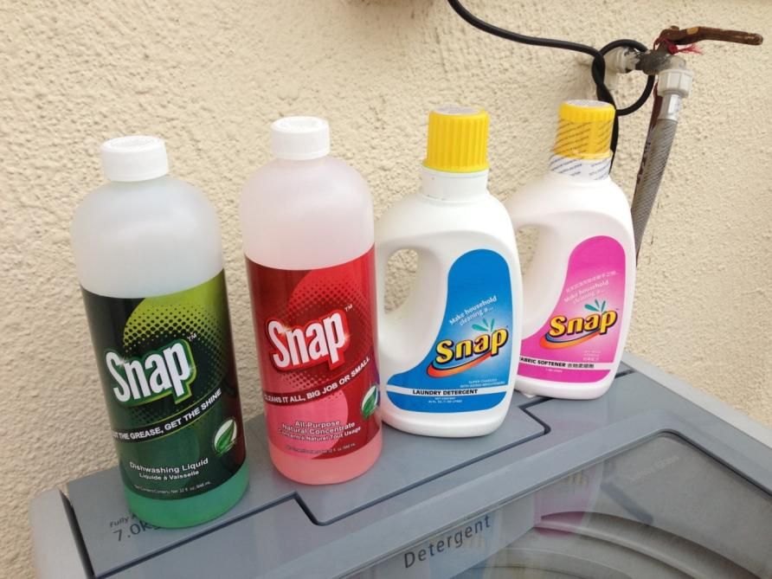

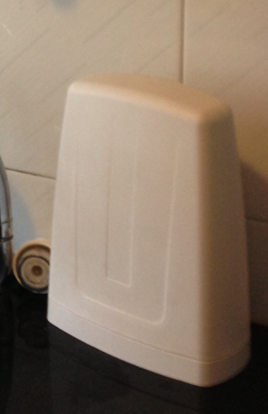
美安家居
MHK Household

Slide 19
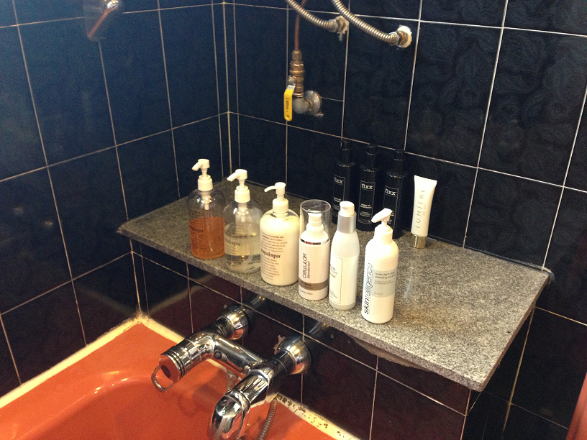
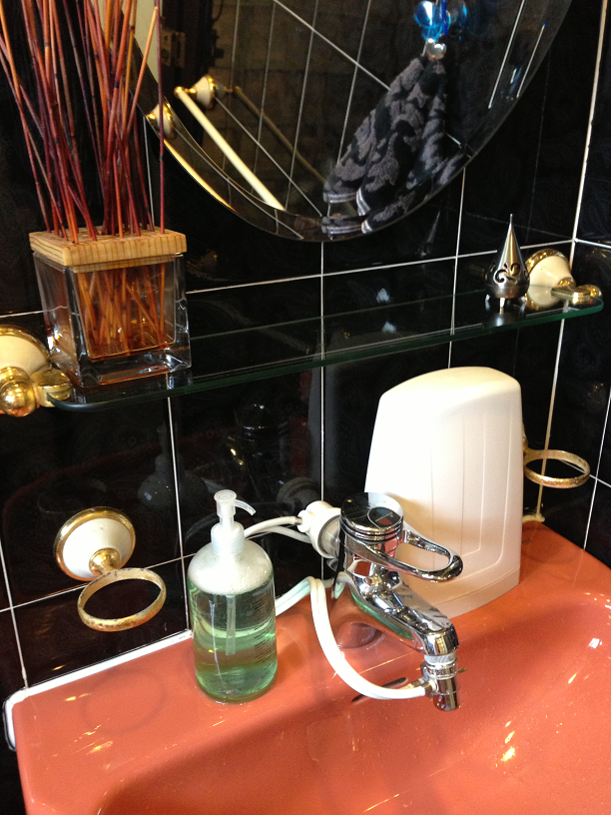
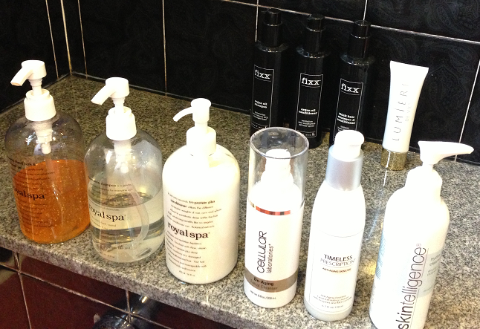
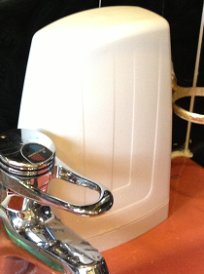
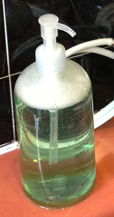
美安家居
MHK Household

Slide 20
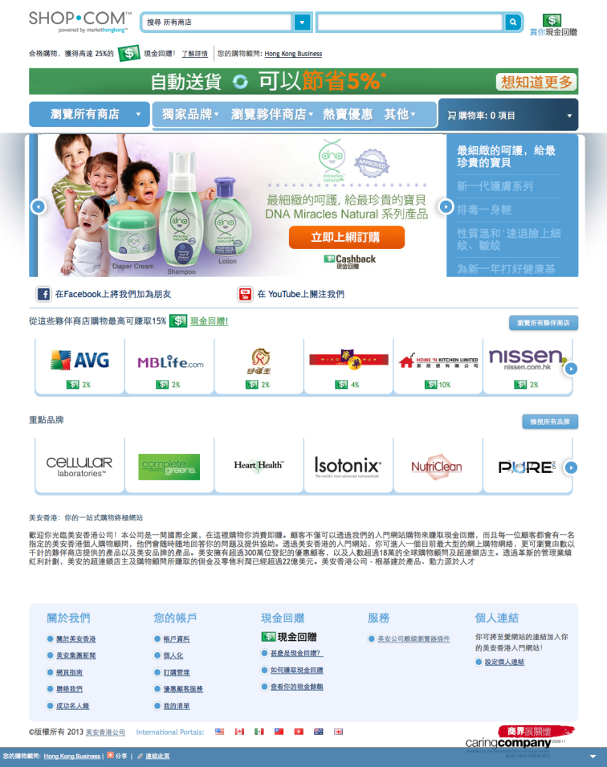

美安現金回贈

Slide 21

你會像他一樣?
Will you do the same?

Slide 22
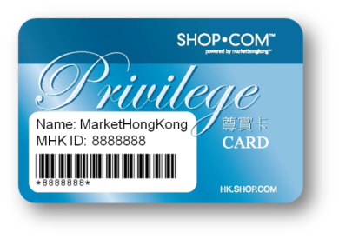



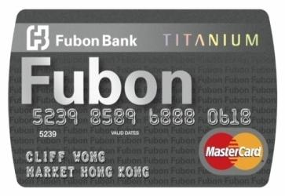
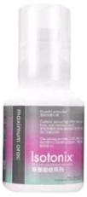
各項優惠
Deals Offered
1
優惠顧客尊賞卡
Privilege Card
2
現金回贈／邀請朋友
Cashback / Invite Friends
$
$
$
$
美安(IBV)產品
MHK(IBV) Products
3
4
獨家代理產品
Exclusive Products
香港／富邦Titanium萬事達卡
mhk/Fubon Titanium MasterCard
Notes:
Nora is the 1st IBV earner, why you can earn the cheque so easy?
Nora : IBV = BV = Bank Account = $
BV=IBV

Slide 23
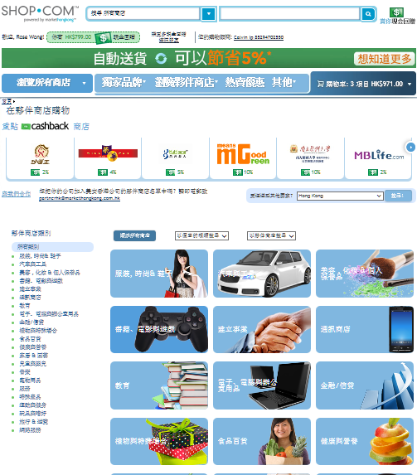
更多的購物年金 – 獎勵業績點數 (IBV)
More Shopping Annuity - IBV
食品
Food
文具
Stationary
電子產品
Electronics
服飾及鞋類
Apparel
旅行及遊覽
Travel
家居用品
Home Care
消閒娛樂Entertainments
兒童用品
Child Products

Slide 24
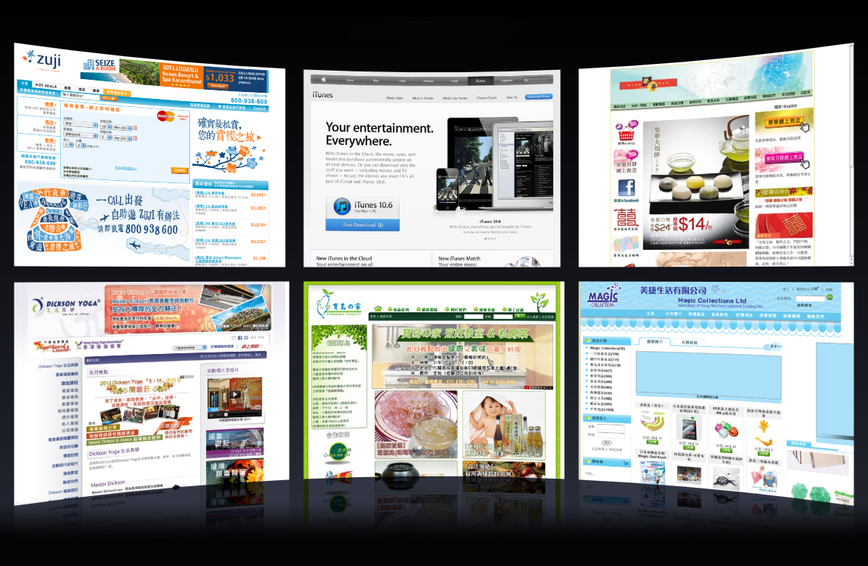
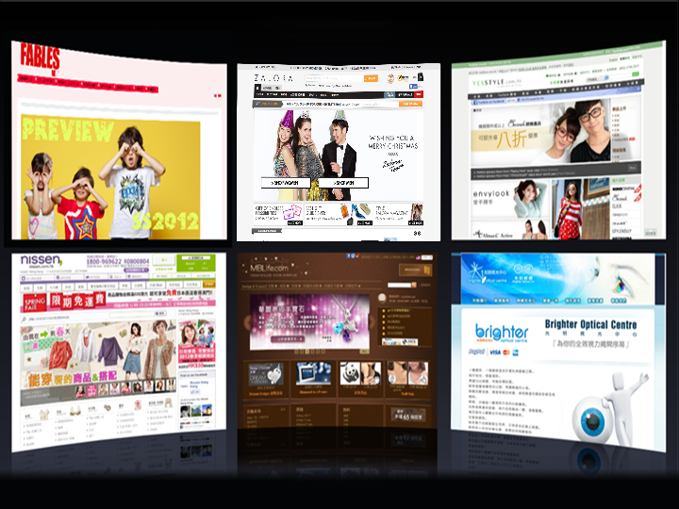
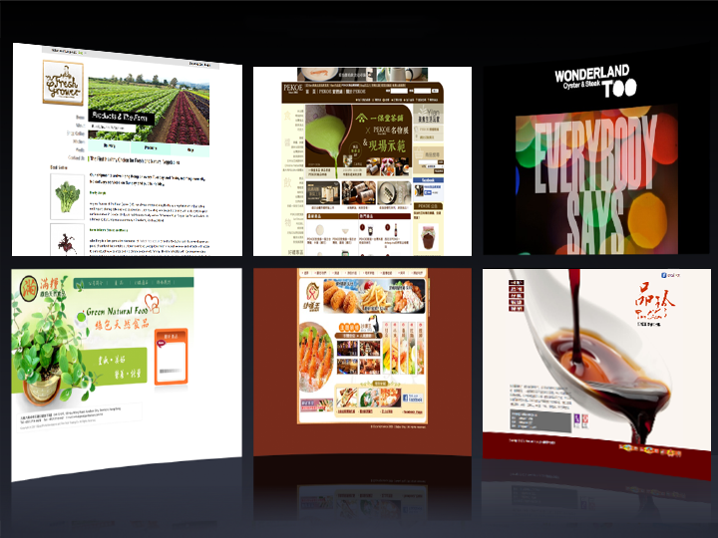
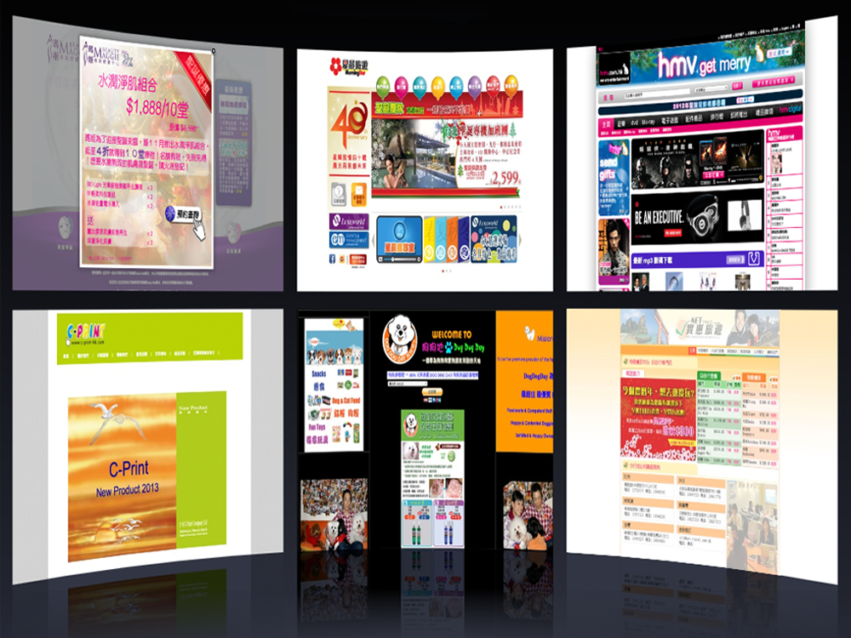
























夥伴商店
夥伴商店
夥伴商店
夥伴商店

Slide 25



熱門優惠
數百項美安獨家品牌產品
社交網絡
購買美安品牌的產品和上有現金回贈圖示的夥伴商店產品，賺取高達25%的現金回贈 。
推薦他人購物，從被推薦人的消費中賺取0.5%的現金回贈 。

Slide 26

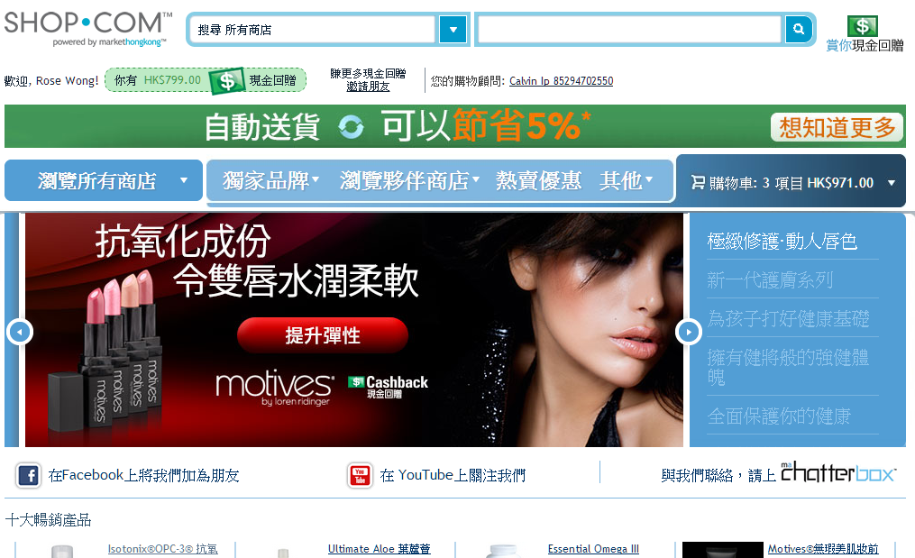
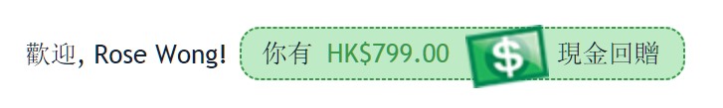
美安現金回贈

Slide 27
節省更多 賺得更多
Save More Earn More
購買美安品牌產品和上有現金回贈圖示的夥伴商店產品，賺取高達25%的現金回贈
現金回贈綜合儲蓄
Earn up to 25 percent cash back for purchasing mhk branded products and those from our Partner Stores where you see the Cashback logo
Save Spending all together with Cashback

Slide 28
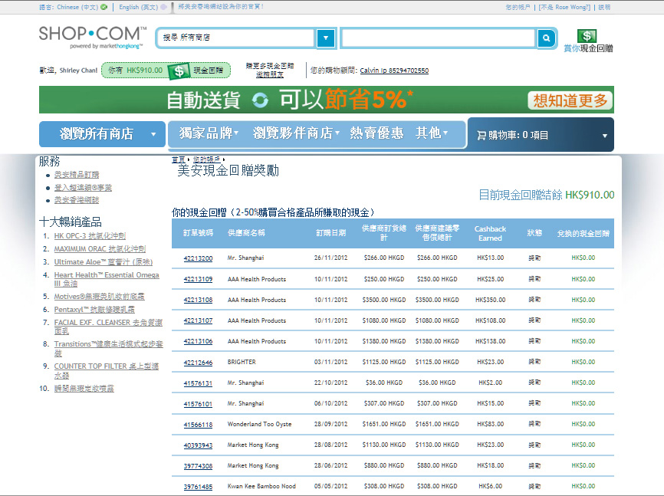
Your current Cashback balance HK$902.00

Slide 29
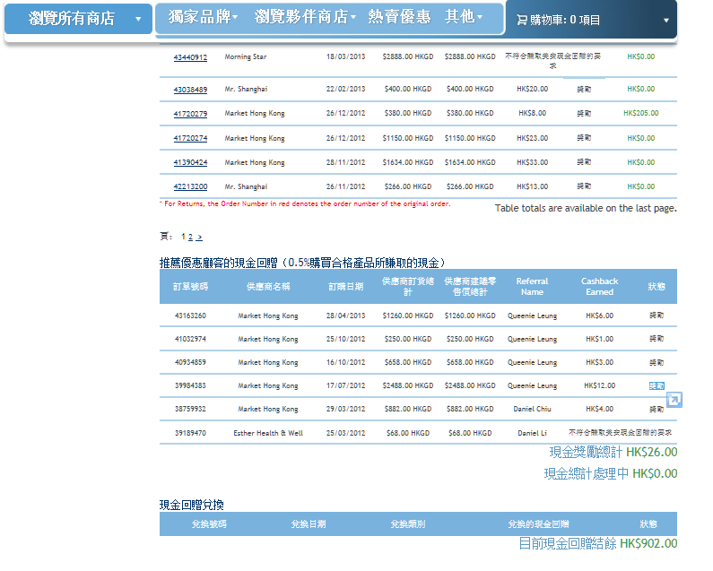

Cashback on referral of Preferred Customers
(0.5% Cashback for every qualified purchase)

Slide 30








一天消費
My Typical Day
2% Cashback
外出用餐 $70
Dining out
糧油食品 $88
Groceries
眼鏡 $139
Glasses
訂購名片 $115
Name cards
美食禮品 $120
Gift Sets
5% Cashback
2% Cashback
$532
3% Cashback
$20
6% Cashback

Slide 31
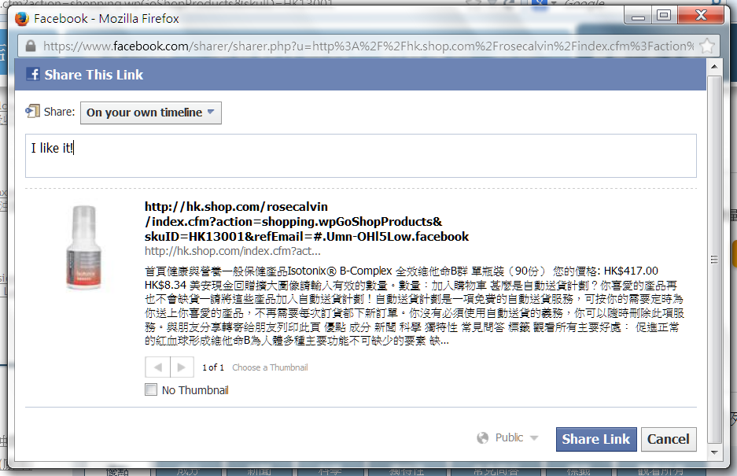
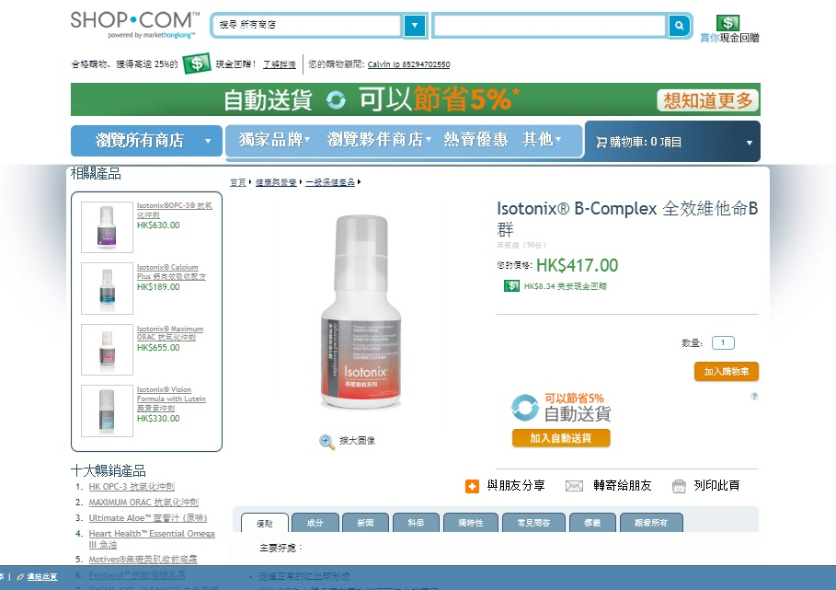
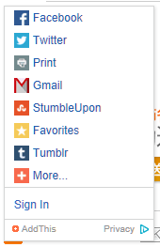
社交購物分享
Social Shopping

Slide 32
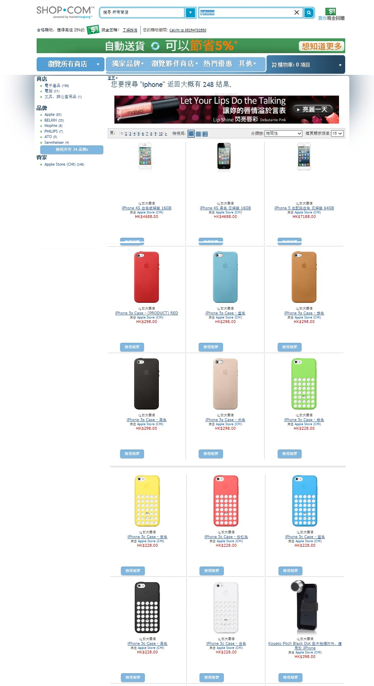
產品搜尋
Product Search

Slide 33
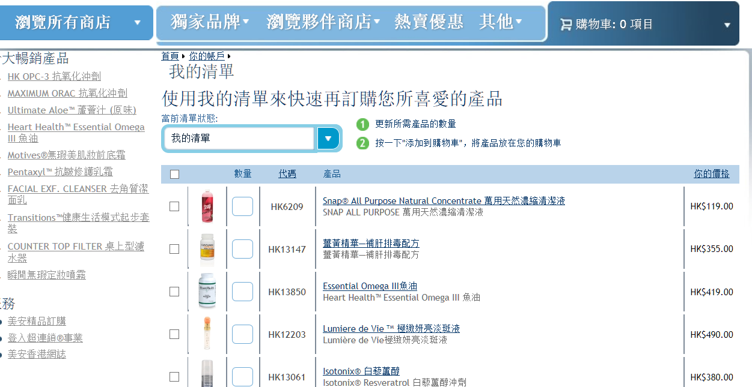
®

Slide 34
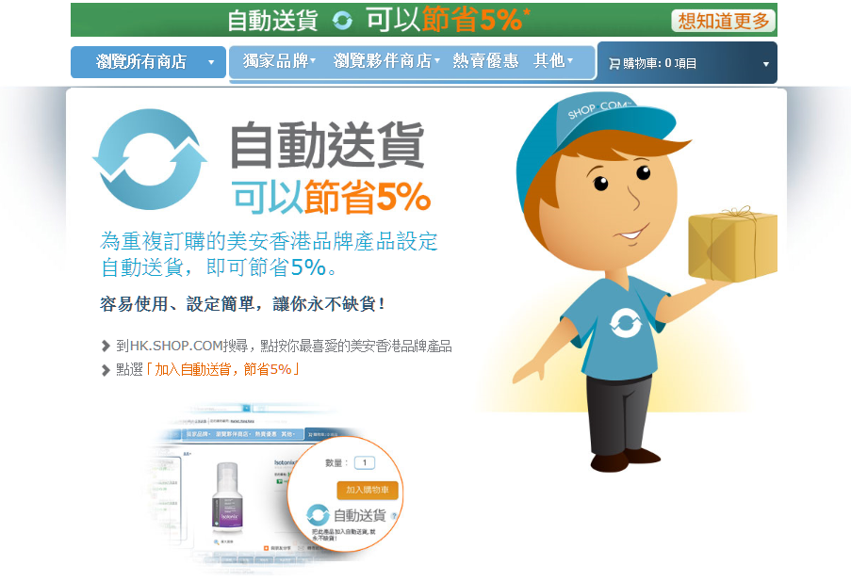

Slide 35
業績點數/獎勵業績點數
BV/IBV
美安現金回贈

Slide 36


Slide 37
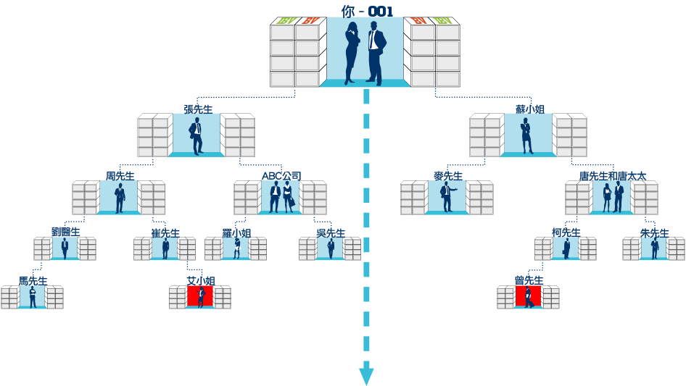
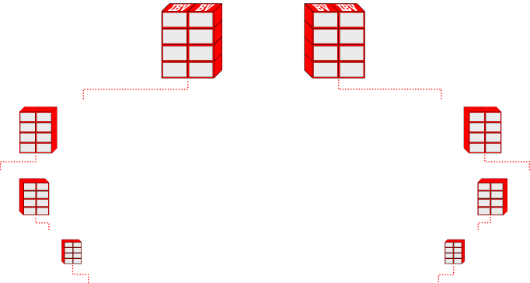





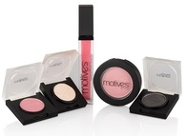



THE SYSTEM SEARCHES FOR BV & IBV TO INFINITY
零售、擴大分銷、優惠顧客透過你的入門網站訂購、購買產品自用與以口碑相傳方式宣傳
Retail sales, expanding distribution, preferred customers ordering through your website, personal use and word-of-mouth advertising
System Search
System Search

Slide 38







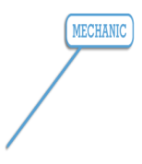
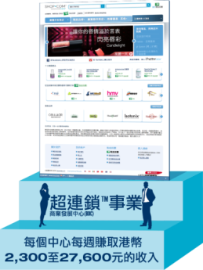





















BV/IBV
$$$$
回贈
10,000 位超連鎖™所店主
10,000 UFOs
100,000 位優惠顧客
100,000 PCs

Slide 39
美安購物年金：
Shopping Annuity is about:
社群經濟的重複消費
帶來永續性收入
Regenerated volume in a monetized community producing residual income.

Slide 40
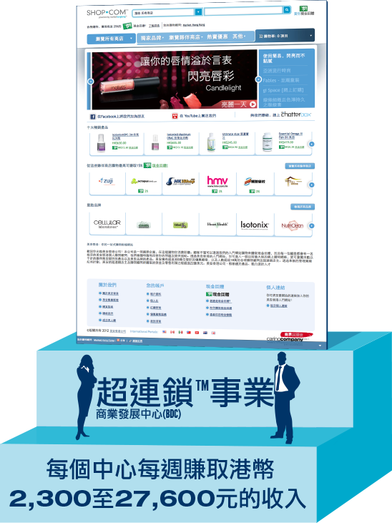
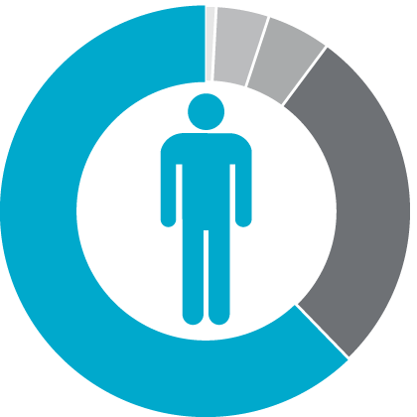
Which would you prefer?
UnFranchiseTM Business Development Center (BDC)
Earn HK$2,300 to $27,600 per week per BDC
45年計劃
45 Year Plan
2到3年計劃
2 to 3 Year Plan

Slide 41

居家購物清單
Home Shopping List
永續收入
Residual Income
購物顧問
一對一行銷
Shop Consultant
One-to-One Marketing

Slide 42


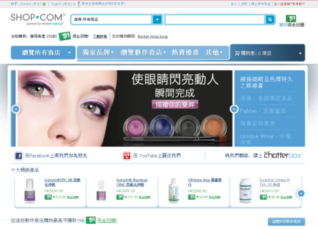
MPCP
- $$$
BV / IBV
購物年金 - 精明消費 作出選擇
把消費轉成投資 賺取永續性收入
Shopping Annuity - Shop Smart
Turn Spending into Residual Income

Slide 43

嶄新的公司，嶄新的機會，嶄新的你
2014美安香港年會
mhk Annual Convention
#MHKAC2014

